Slide 1
Microwave Devices E511
Lecture 9
Amr Al.Awamry

Slide 2
Agenda
BASIC PROPERTIES OF DIVIDERS AND COUPLERS
T-junction
Circulators
Four-Port Networks (Directional Couplers)

Slide 3
BASIC PROPERTIES OF DIVIDERS AND DOUPLERS
With Matched Ports

Slide 4
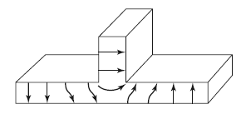
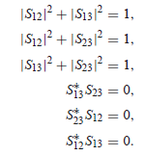
T-junction ….. Reciprocal

Slide 5
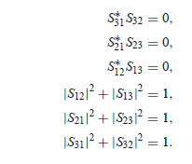
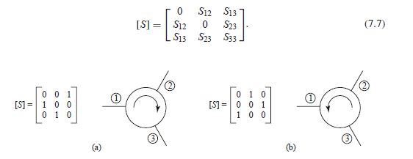
Circulators
Given that

Slide 6
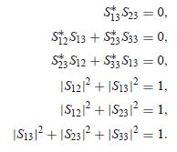
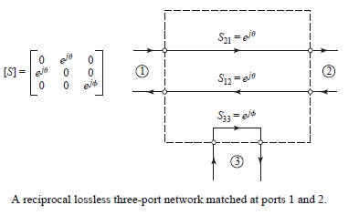
Non matched port 3
Lead to

Slide 7
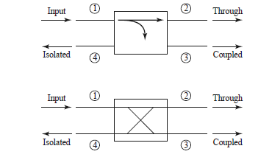
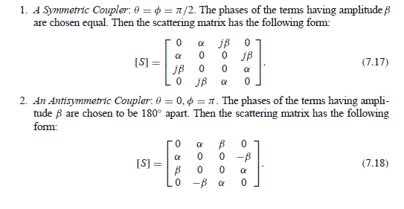
Four-Port Networks (Directional Couplers)

Slide 8
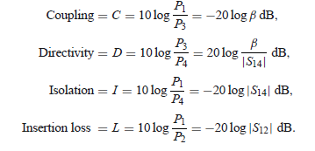
Directional Couplers… cont
Quadrature hybrid
Magic T hybrid

